Slide 1
INVESTMENT CASE STUDY SUBMISSION
Team Members:
Deepak Aneja
Fayiz Mayamveettil
Merin Jose
Suresh Balla

Slide 2
Understanding Global Trends in Investments
Business Scenario
Spark Funds has a budget of 5 to 15million USD to be invested in a few companies which are based out of an English speaking country.
The overall strategy is to invest where others are investing, implying that the best sectors and countries are the ones where most investments are happening.

Slide 3
Problem solving methodology
Get the average investment for each investment type (venture, angel, seed, and private equity) and choose the best one as per the budget
Identify the best sector within selected countries for preferred investment type based on previous analysis and for 5 – 15 M budget
Understand the datasets
Clean the datasets
Identify the top countries which received most funding based on the above chosen investment type
Understand the keys and relation between data sets
Based on the analysis, arrive at a conclusion
Identify the top three English speaking countries
Start the Analysis

Slide 4
Funding Type Analysis
Average overall Funding in select Investment types
Preferred Investment Type: Criteria – Basis Overall Average funding between 5 – 15 M
Results/ Recommendation
Only Ventures has average investment within 5 – 15 M and so is preferred funding type
Other Observations
59.60% of the total amount invested globally is on Venture Type Investment
On slicing further on Angel, Seed, private equity and Venture, 78.30% out of these four are of Venture types.
Investment | Average Funding
Venture | 11,748,949.10
Angel | 958,694.50
Seed | 719,818.00
Private Equity | 73,308,593.00

Slide 5
Country Analysis
Main criteria
Invest in one of the most heavily invested countries
Invest in an English speaking country
Results/ Recommendation
United States of America
United Kingdom of Great Britain and Northern Ireland
India
*Considering United Kingdom of Great Britain and Northern Ireland as native English speakers

Slide 6
Sector Analysis
Main Criteria
Selected Investment type Venture
Top 3 English speaking countries
Each funding between 5 to 15 M,
Best sectors to invest based on the number of investment on each sector for each country.
Analysis:
Results/ Recommendation
Sector Others and "Social, Finance, Analytics, Advertising" are first 2 preferred sector for all 3 countries.
“Cleantech / Semiconductors” is the 3rd preferred sector for US and UK but for India 3rd Preferred sector is “News, Search and Messaging”
Country | Sector | Investments
United States of America | Others | 2950
 | Social, Finance, Analytics, Advertising | 2714
 | Cleantech / Semiconductors | 2350
United Kingdom of Great Britain and Northern Ireland | Others | 147
 | Social, Finance, Analytics, Advertising | 133
 | Cleantech / Semiconductors | 130
India | Others | 110
 | Social, Finance, Analytics, Advertising | 60
 | News, Search and Messaging | 52

Slide 7
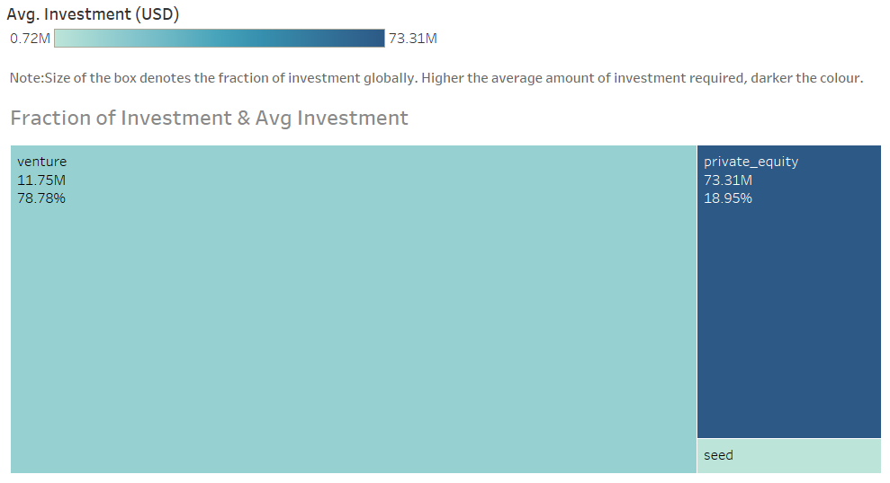
Investment Type Analysis

Slide 8
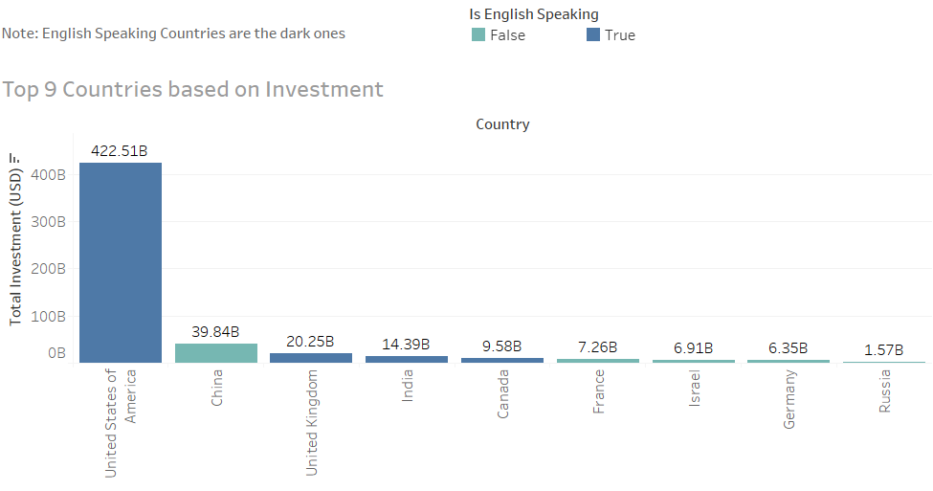
Top 9 Countries Based on Investment

Slide 9
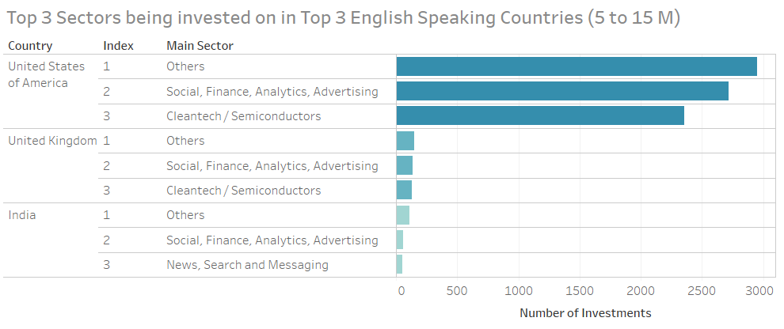
Top 3 English Speaking Countries and its Top 3 Sectors
Top 2 primary sectors for USA and Others main sector:
software
enterprise software
Top 2 primary sectors for UK and Others main sector:
software
e-commerce
Top 2 primary sectors for India and Others main sector:
e-commerce
software

Slide 10
Conclusion
Spark Funds should invest in Ventures
Highest Invested countries USA, UK or India should be Preferred
“Others”, “Social, Finance, Analytics, Advertising” are top 2 preferred sector for all these three countries
Within others main sectors, below are top 2 primary sectors which can be considered for investment
software and enterprise software for USA
software and e-commerce for United Kingdom of Great Britain and Northern Ireland
e-commerce and software for India
“Cleantech / Semiconductors” are 3rd preferred sector for US and UK and for India 3rd Preferred sector is “News, Search and Messaging”

